Slide 1
PLA Workshop London Sport – Active Environments / Facilities
Chris Donkin
10th December 2025

Slide 2
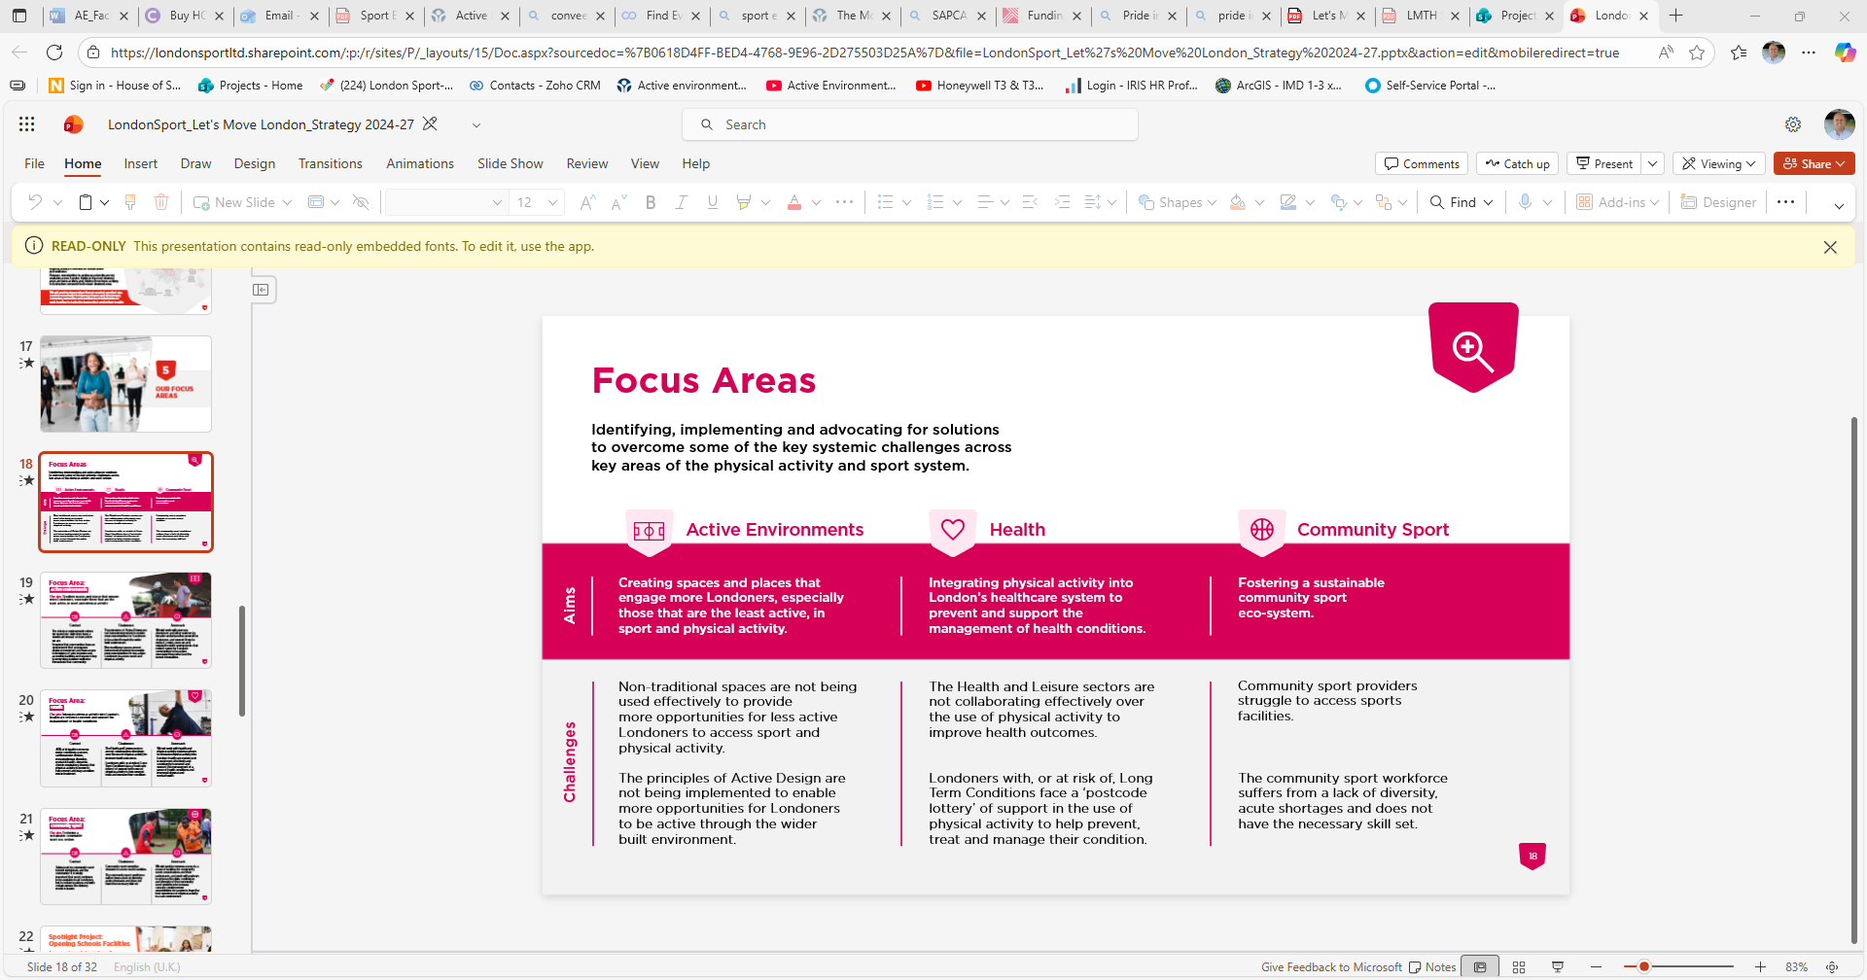

Slide 3
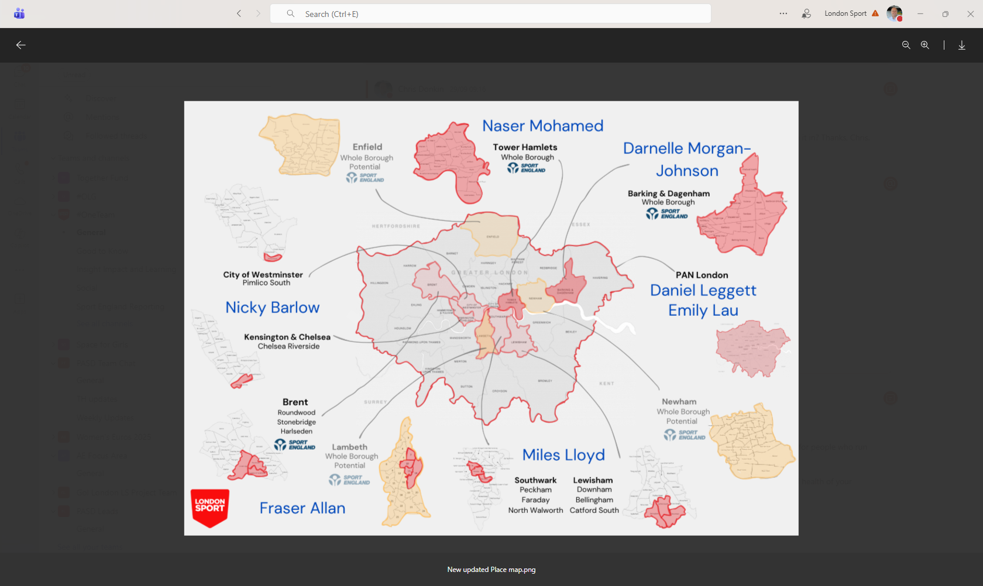
Place

Slide 4
Workforce
Piloting a new approach that strengthens the role of grassroots community sport in supporting people with long term health conditions. The ambition is to create more "health ready" community sport settings by upskilling the workforce, improving confidence, and ensuring clubs feel equipped to support people who are currently inactive or require structured physical activity as part of management of their health condition.
Focused work to develop inclusive practice within the sector. Recently delivered a disability inclusion focused National Governing Body (NGB) Roundtable with the Activity Alliance which helped to build the confidence of a range of NGBs in offering more accessible and inclusive programmes.
Working with Chartered Institute for the Management of Sport & Physical Activity (CIMSPA) in North East London to undertake a skills diagnostic and establish a North East London Local Skills Accountability Board (LSAB) representing employers, education, local authorities, community organisations, and health bodies.
Workforce development directly to clubs through the Sports Welfare Officer programme. Key stats include: Intensive support provided to 130 clubs / groups, 63 clubs/ groups received intensive support between March-August (Top 2 - Athletics and Rowing clubs) and Engagement with 44 NGBs

Slide 5
Active Environments – Challenge 1
What do we mean by Non Traditional Spaces and why are they so important?
Overview of the specific items under each area of focus.
Current work London Sport are completing under Challenge 1.
KEY AREAS OF FOCUS
Awareness Connections
Influence + Advocacy
Adapting Activity
Sustainable Operation

Slide 6
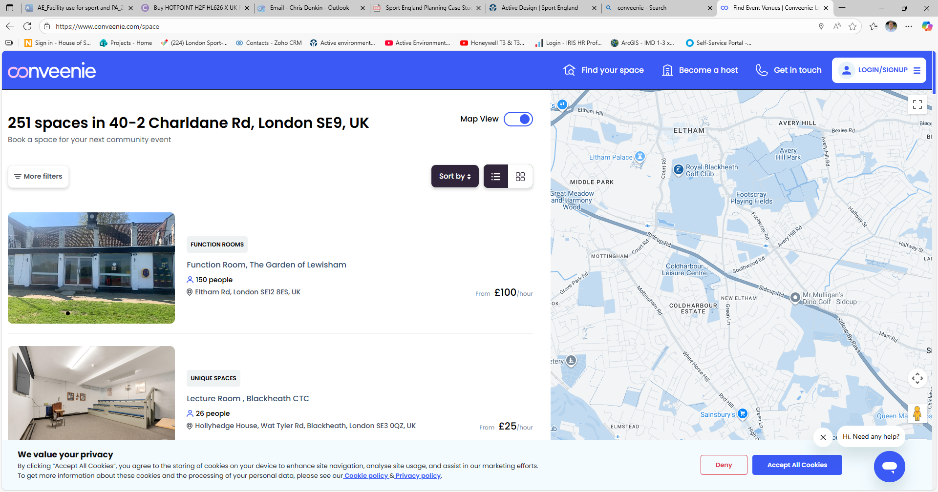
Future Work

Slide 7
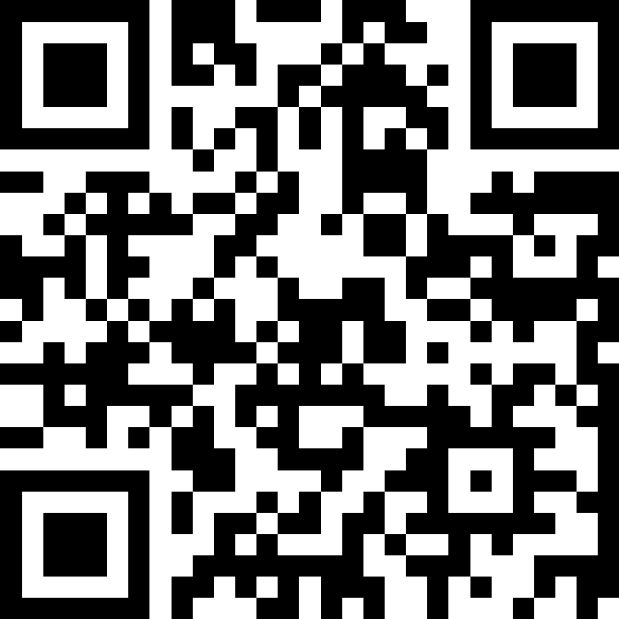

Slide 8



Do not edit How to change the design
Does your venue have a
The Slido app must be installed on every computer you’re presenting from

Slide 9
Do not edit How to change the design
Do you use your facilities for activities beyond your main operations - ie open to the community for different activities?
The Slido app must be installed on every computer you’re presenting from

Slide 10

Do not edit How to change the design
What is the main thing that is stopping you from using your facilities for more activity?
The Slido app must be installed on every computer you’re presenting from

Slide 11
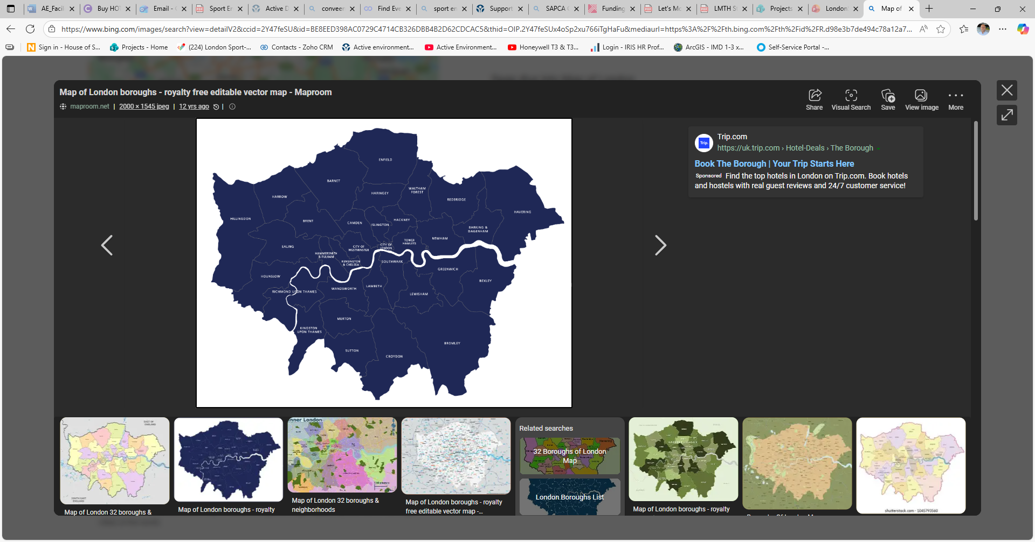
Future London Sport Work

Slide 12
Go! London - Innovation Challenges
Go! London will soon be launching a new series of Open Innovation Challenges – calling for bold ideas that use SPA to build stronger, more resilient communities for CYP in London.
The Challenges will focus on:
1) Sport for Climate Action
2) Reimagining Spaces for Sport and Play
Information about the programme including funding criteria, funding levels and timescales will be released in the upcoming weeks.
London Sport, as one of the Go! London partners, will be sharing information.
For more info, contact: Chris.Donkin@londonsport.org or Ellie.Sheppard@london.gov.uk

Slide 13
Challenge 1 - Sport for Climate Action
Driving Climate action through awareness, capacity building and engagement:
We are looking for community-led solutions that use sport and physical activity as a powerful platform to build climate awareness, shift attitudes, and inspire meaningful action in young people.
We welcome ideas that build skills in climate literacy and resilience or use the collective spirit of sport and physical activity to drive community-level climate action.
Enabling climate-resilient participation of children and young people:
We are looking for community-led solutions that help sport and physical activity adapt to the realities of climate change, or that are reducing their environmental impact.
We welcome ideas that embed sustainability into sport settings, enabling children, young people, and organisers to participate responsibly while maintaining access, safety, and enjoyment.

Slide 14
Challenge 2 - Reimagining Spaces for Sport & Play
We welcome solutions that increase the availability of safe, inclusive, and affordable spaces for sport and physical activity by adapting or re-imagining spaces that were previously not used for this purpose.
We are also looking for solutions that make existing spaces for sport and physical activity more inclusive, welcoming and relevant to bring in young people previously excluded from those spaces.
You might do this by tackling the economic, social, and cultural barriers to participation and increasing the visibility and uptake of opportunities.
Notes:
You might be doing this by reimagining the way existing spaces can be used building new tools
and models for equitable access, implementing entrepreneurial strategies that secure
resources that improve participation opportunities, and implementing design and accessibilityinterventions that embed play into everyday urban environments.

Slide 15
Funding Opportunities and Other Resources
Sport England Movement Fund.
Grants/Pledges from £300-£15,000
Funding can support improvement/creation of new spaces or providing equipment.
Other eligible items include creating new sessions, capacity building, environmental sustainability.
Open funding programme- Decisions typically within 6-8 weeks.
Pride in Place
Pride in Place
Pride in Place Impact – B&D, Brent, Croydon, Enfield & Newham.
SAPCA Grant Finder - Funding Providers – SAPCA
Buddle - Supporting grassroots organisers | Sport England
Notes:
You might be doing this by reimagining the way existing spaces can be used building new tools
and models for equitable access, implementing entrepreneurial strategies that secure
resources that improve participation opportunities, and implementing design and accessibilityinterventions that embed play into everyday urban environments.

Slide 16
Social media

Slide 17
Questions for you
Who has posted something on social media in the last 24 hours, either personally or for your organisation?
Who feels confident about posting on behalf of their organisation?
Who has to often de-prioritise their social media efforts?

Slide 18


Channel breakdown: Facebook
Best practice for this platform:
Maximum word count: 200 words
Always use an image
Add a clear call to action to your post with a link, just before the hashtags
Use maximum five hashtags

Slide 19


Channel breakdown: Instagram
Best practice for this platform:
Maximum word count: 200 words
Always use an image or video
Add a clear call to action to your post directing people to your LinkTree, just before the hashtags
Do not put the link in the text
An incoming platform update will limit the number of hashtags you can use in a caption to only three

Slide 20


Channel breakdown: LinkedIn
Best practice for this platform:
Maximum word count: 200 words
Always use an image
Add a clear call to action to your post with a link, just before the hashtags
Use maximum five hashtags
Tag companies or individuals that you mention

Slide 21
How, What, Where and When?
How?
Social media scheduling tools are available to support with consistency and regularity of posting
Manual posting is also fine!
What?
The chance of your post catching someone's attention is increased when you use visuals, such as imagery or videos
Video is popular right now – particularly among young people!
Where?
Find the right platforms that work for your audience
Not all posts work for all platforms – for example, a post relevant on LinkedIn may not be relevant to your Instagram audience
When?
Keep post time consistent across all platforms– consider what time your audience is most active
Ideally, post on each platform 3-5 times per week. If content is limited, ensure you post no less than once.

Slide 22

Analytics
Why it’s a good idea to investigate your analytics:
You might be surprised by what resonates most with your audience
You can post less of the content types that your audience don't engage with
You can use the data to create a strategy

Slide 23

Top Tips
Consistency is key
Proof before you post
Limit hashtags
Add links into LinkTree (Instagram)
Check you have image permissions and credit the owner
Create a brand hashtag that goes on every post (Eg: #PortOfLondon or #ActiveThames)

Slide 24
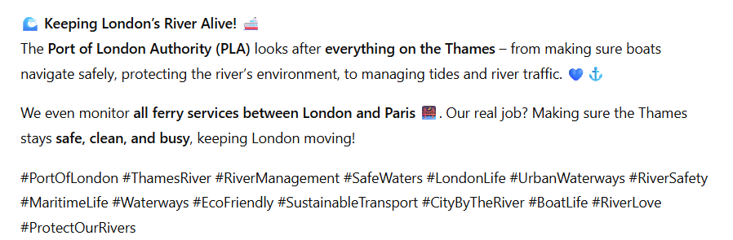
AI Tools Guidance
Use AI wisely - it is a great spellchecker but shouldn’t be used for writing everything!
Look out for...
American language or spellings
Too many hashtags
The EM dash
Incorrect information – AI sometimes adds to your content!
Excessive emojis and word capitalisation
Losing the human touch
Here's an example of a bad post written by AI

Slide 25



THE IMPORTANCE OF A SAFEGUARDING CULTURE

Slide 26
safeguarding essentials
policies
codes of conduct
procedures
training
safer recruitment
Culture isn’t part of safeguarding, it’s the heart of it!

Slide 27




safeguarding culture - what does this really mean?
Placing welfare, safety and wellbeing at the heart of your organisations values & actions.
Listening to children and young people voices - making sure they feel respected & involved in decisions that affect them.
Creating an environment where everyone can feel confident that their concerns will be heard and addressed appropriately.
Everyday behaviours, language, attitudes and a commitment to looking out for each other.
Staff and volunteers who are confident and feel supported and equipped to recognise and respond appropriately.
culture is the golden thread that runs through every policy, every meeting, every decision, every interaction

Slide 28
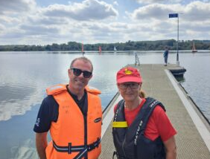


CASE STUDY

Slide 29
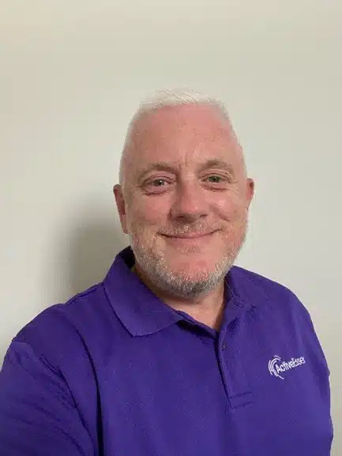
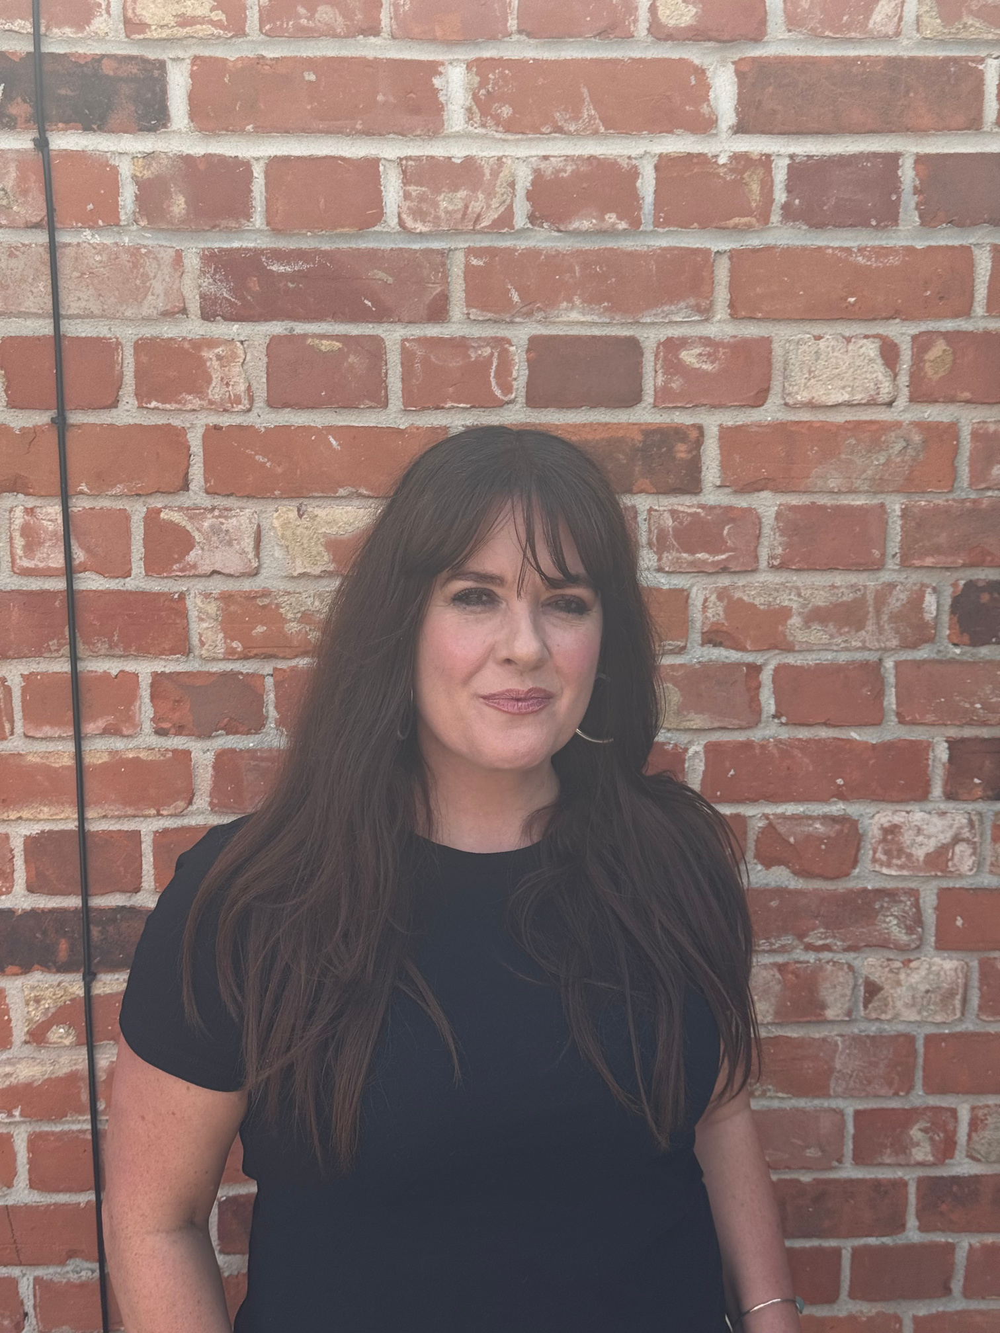


how you can work with us at active essex
Check out our Safeguarding Hub
Please do get in touch should you have any questions!
wayne.hickey@activeessex.org
marianne.appleton@activeessex.org

Slide 30
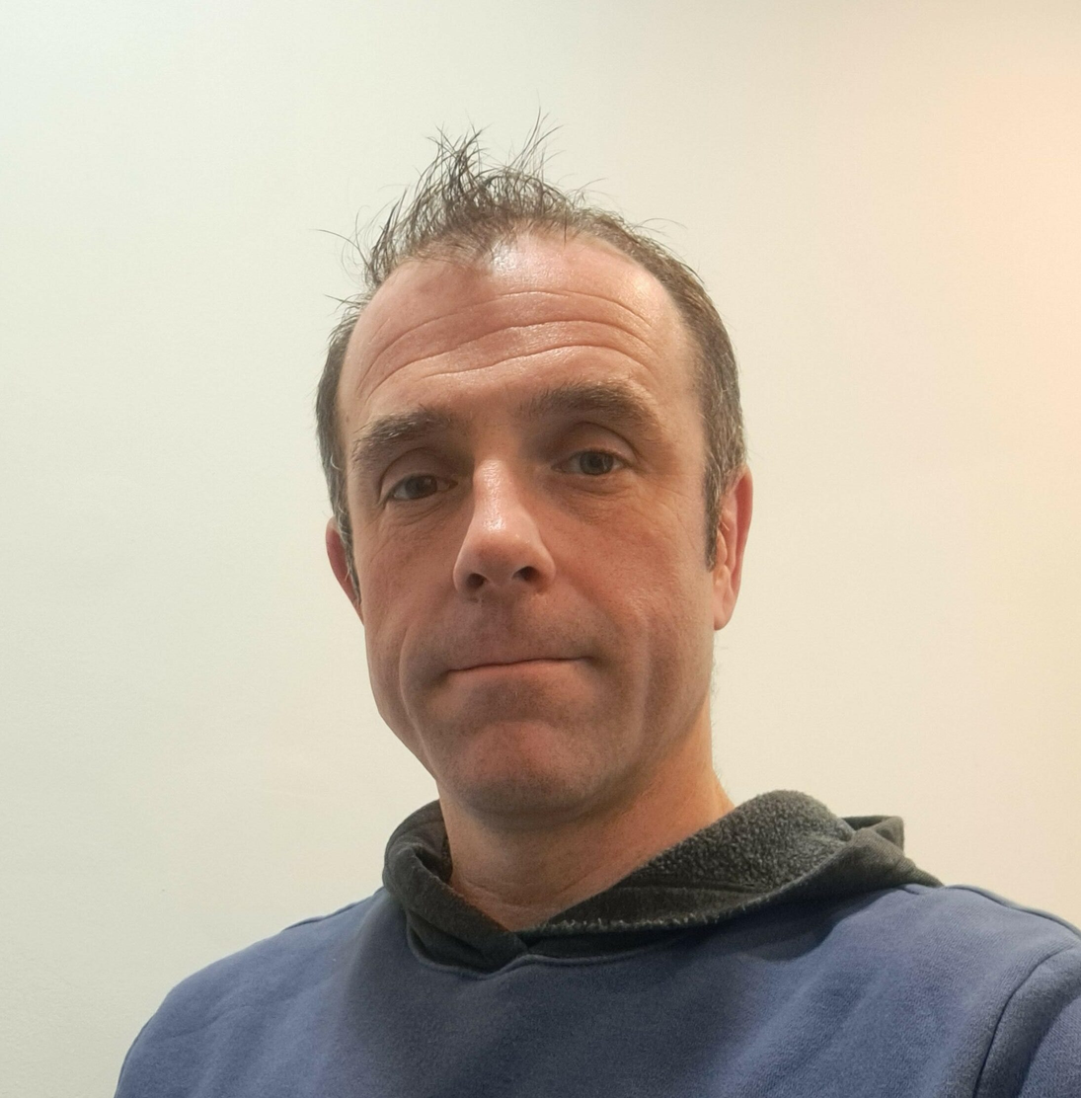
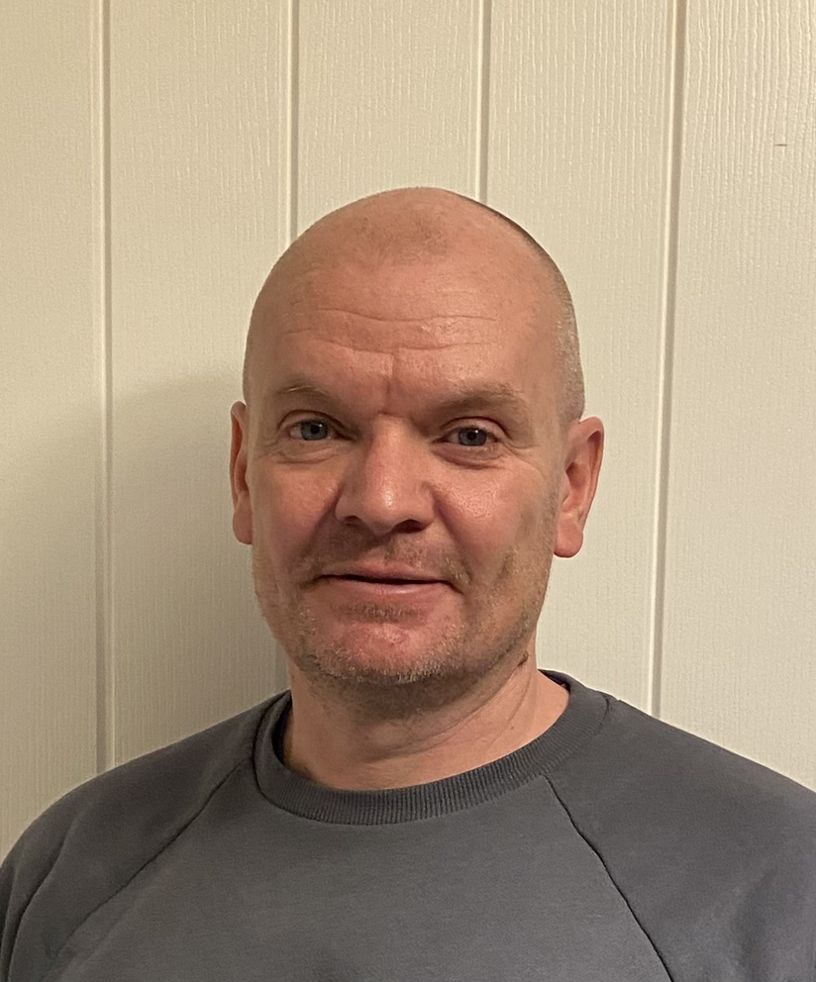
how you can work with us at active kent & medway
Active Kent & Medway website
Please do get in touch should you have any questions!
stuart.butler@kent.gov.uk
jimmy.mccormack@kent.gov.uk

